Slide 1
WELCOME

Slide 2
Database Project
Restaurant Management System

Slide 3
Presented By
Md. Musfiqur Rahman Sumaiya Akter
18201054 18201056

Slide 4
About
The primary objective of the project is to develop a database on restaurant management system. By using this project, we get an clear idea on how the database works on a restaurant and how to use.

Slide 5
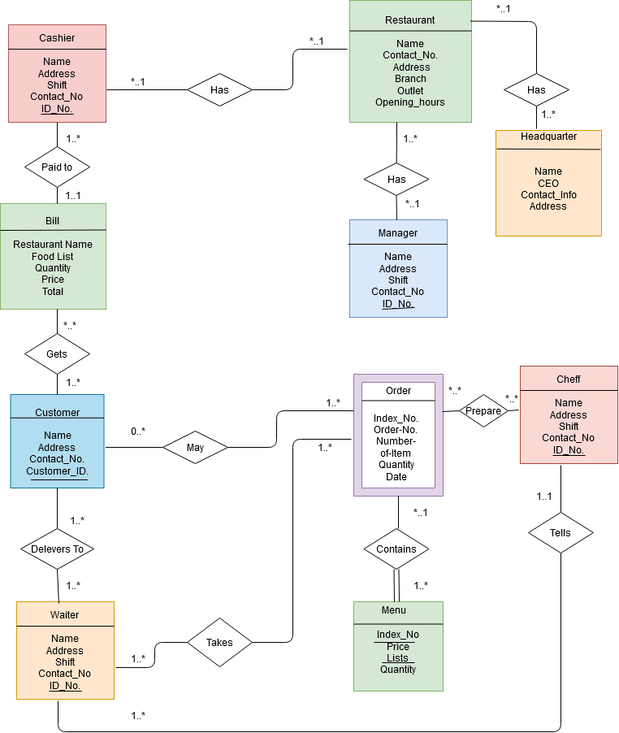
Design

Slide 6
Sample Quirey
SELECT CONCAT(Firstname,Lastname) AS Name, Date
FROM customer
WHERE Address LIKE '%Farmgate'
Order BY Name ASC;

Slide 7
Outcome
Easily handle the restaurant system
Get record of anything about the restaurant
We can analyze most ordered menu
Fulfill basic data requirement of online market
Accessible data of customer, crew, payment details

Slide 8
Now we go for Demonstration!

